Slide 1
Natural Disaster
SlideMake.com

Slide 2
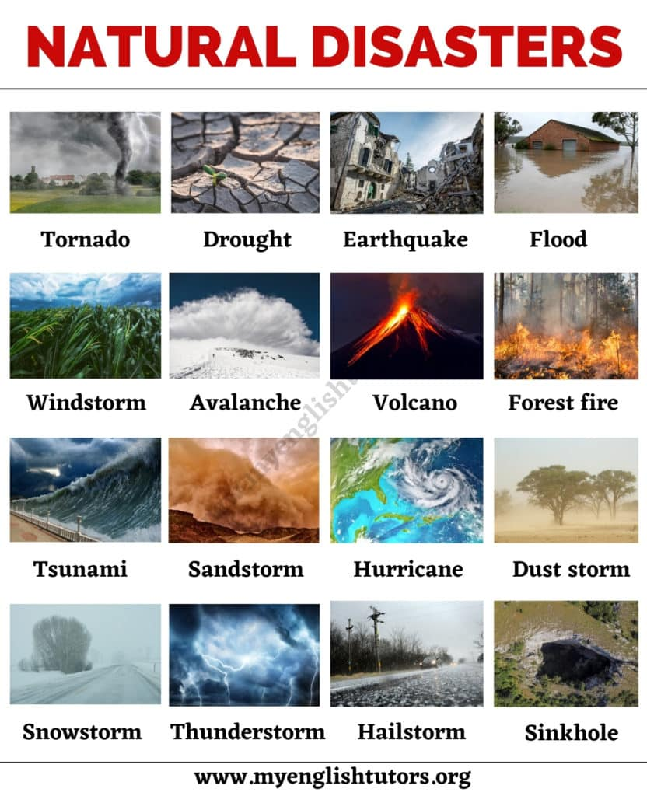
Introduction to Natural Disasters
Natural disasters are sudden and extreme events caused by natural forces.
They can have devastating impacts on the environment, infrastructure, and human lives.
Common types of natural disasters include earthquakes, hurricanes, floods, wildfires, and tsunamis.
1

Slide 3
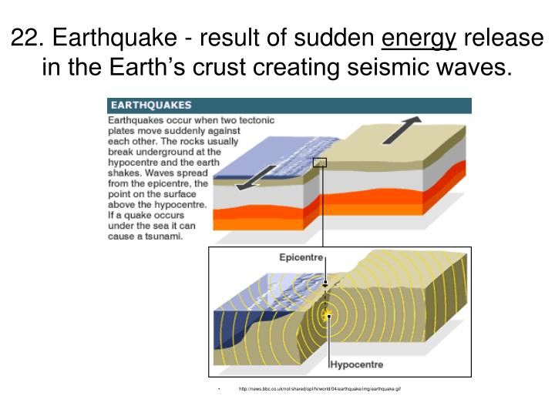
Earthquakes
Earthquakes occur when there is a sudden release of energy in the Earth's crust.
They can cause ground shaking, surface rupture, and sometimes tsunamis.
Earthquakes are measured using the Richter scale, which measures the magnitude of the seismic waves.
2

Slide 4
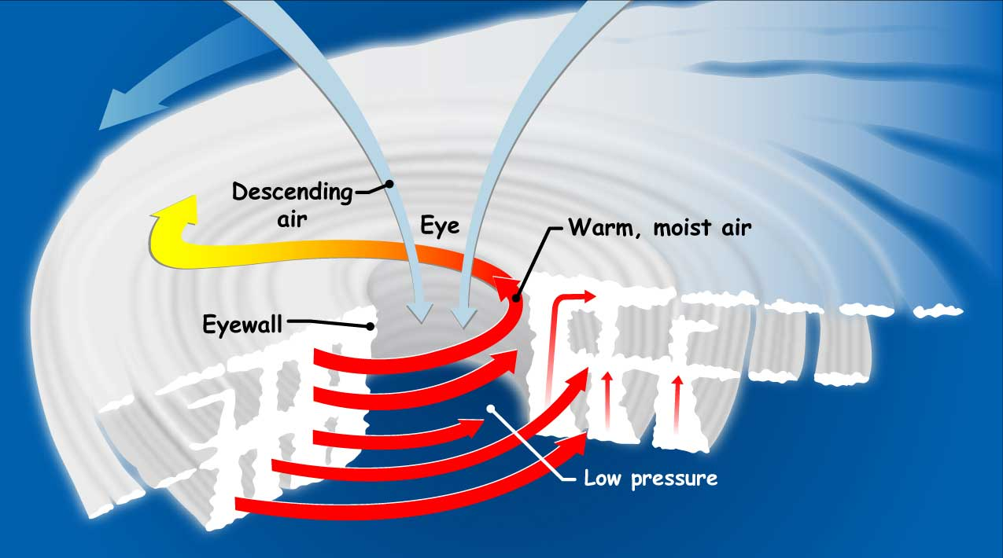
Hurricanes
Hurricanes are large rotating storms with strong winds and heavy rainfall.
They form over warm ocean waters and can cause widespread destruction.
The Saffir-Simpson Hurricane Wind Scale is used to categorize hurricanes based on their wind speeds.
3

Slide 5
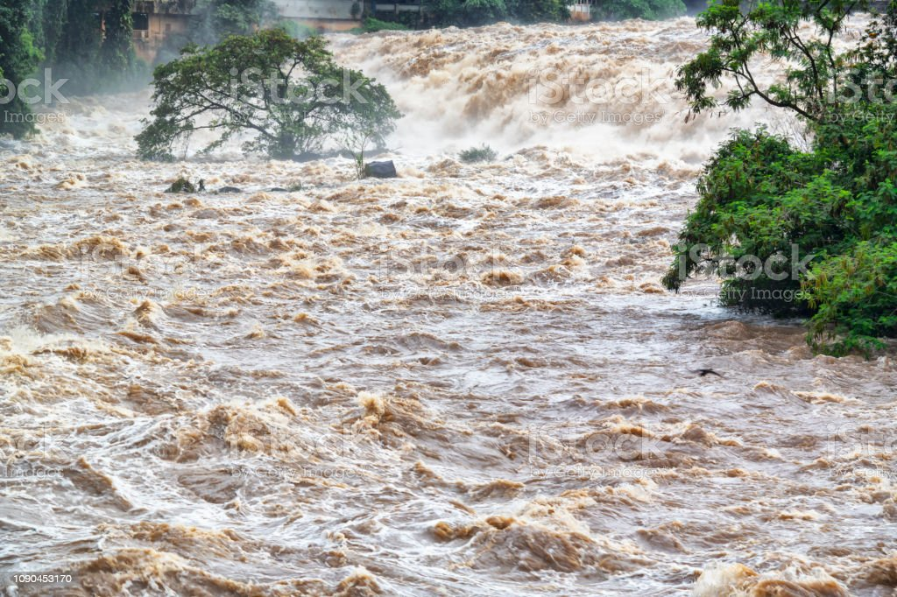
Floods
Floods occur when there is an overflow of water onto normally dry land.
They can be caused by heavy rainfall, melting snow, or dam failures.
Floods can lead to property damage, displacement of people, and the spread of waterborne diseases.
4

Slide 6
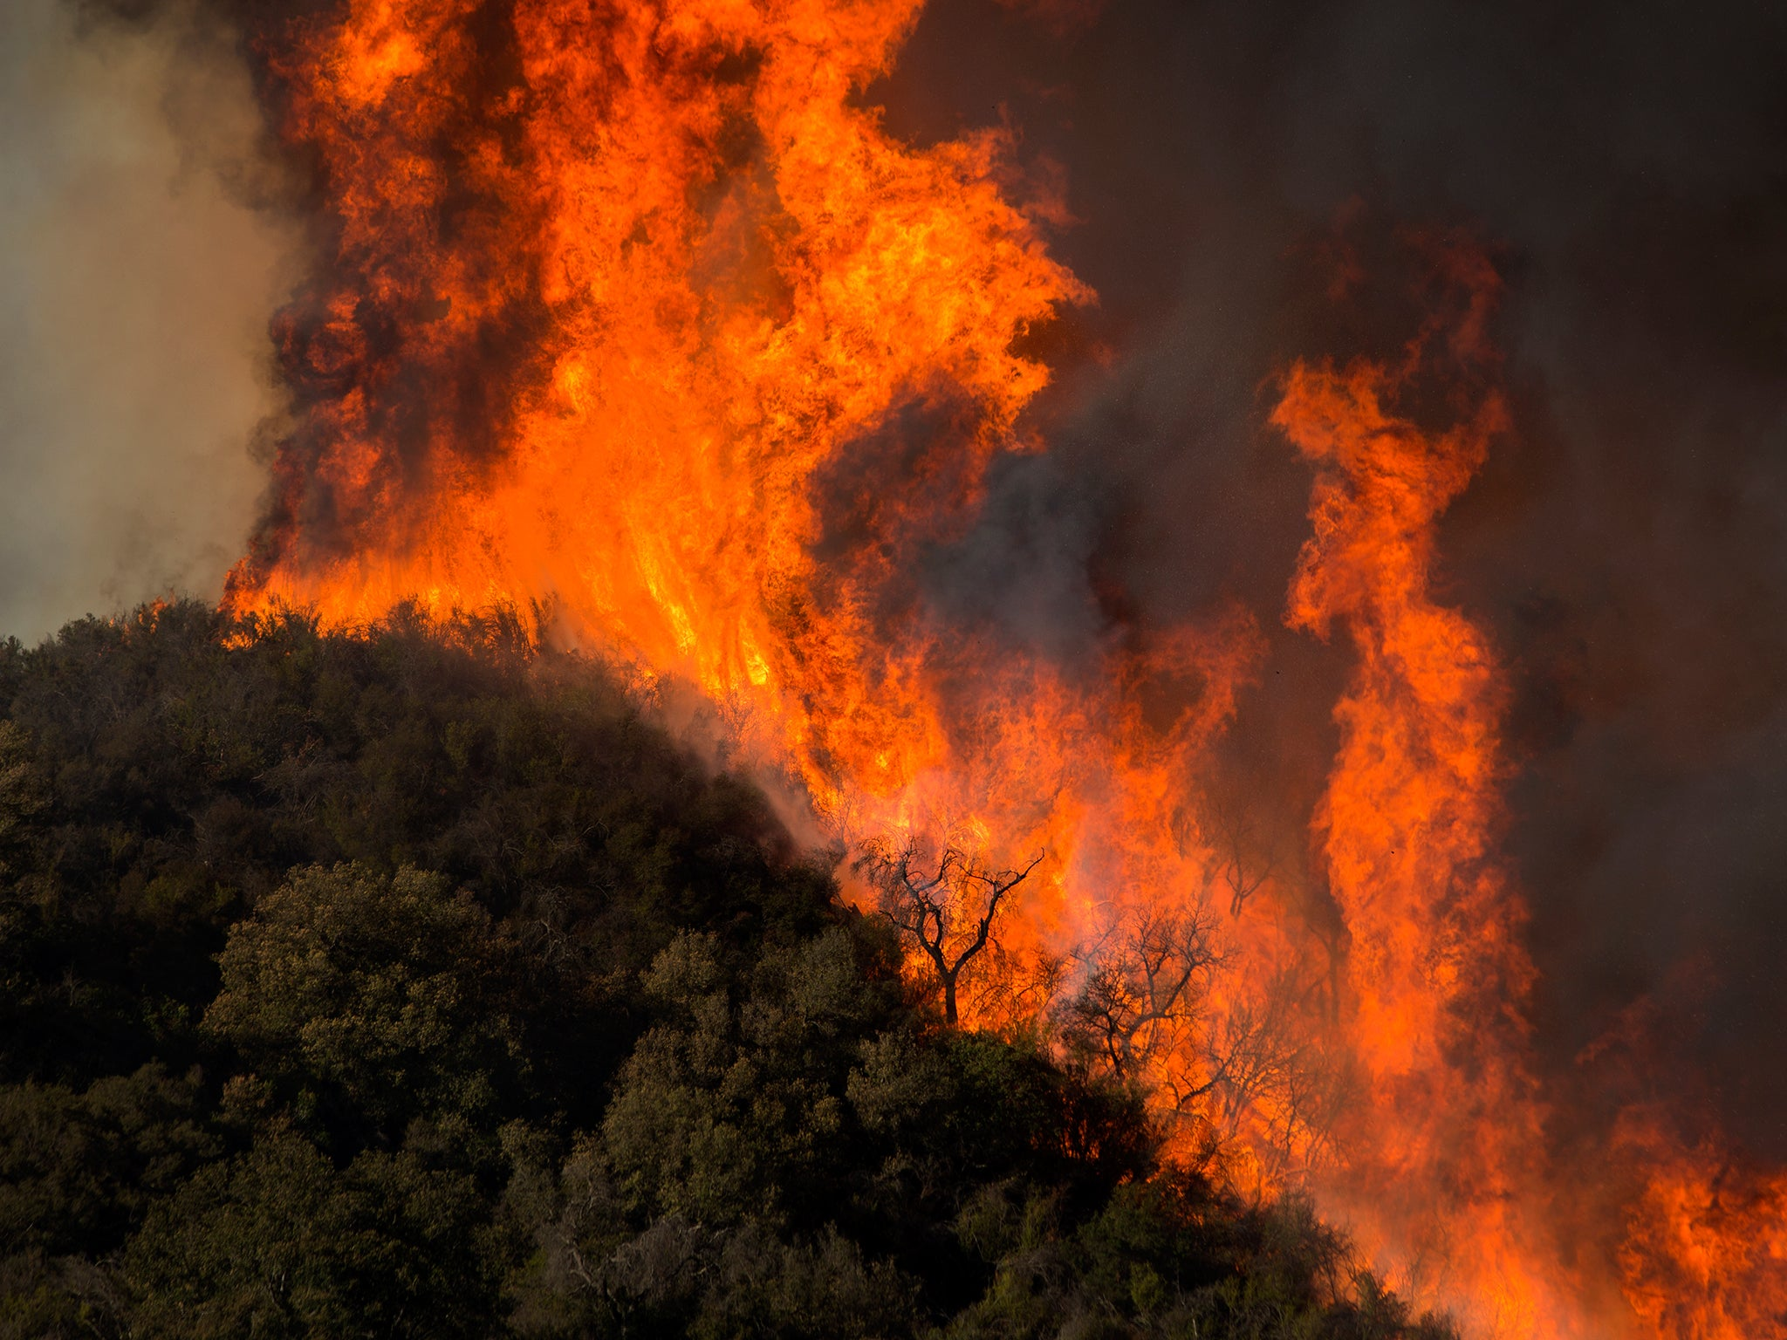
Wildfires
Wildfires are uncontrolled fires that spread quickly through vegetation.
They can be caused by natural factors like lightning or human activities.
Wildfires can destroy forests, homes, and habitats, and produce harmful smoke and air pollution.
5

Slide 7
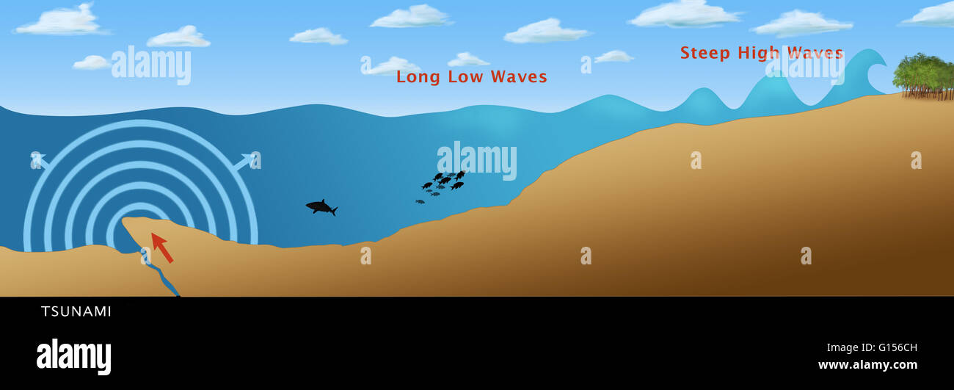
Tsunamis
Tsunamis are large ocean waves triggered by undersea earthquakes or volcanic eruptions.
They can travel across the ocean at high speeds and cause widespread damage along coastlines.
Early warning systems are in place to help mitigate the impacts of tsunamis and save lives.
6

Slide 8
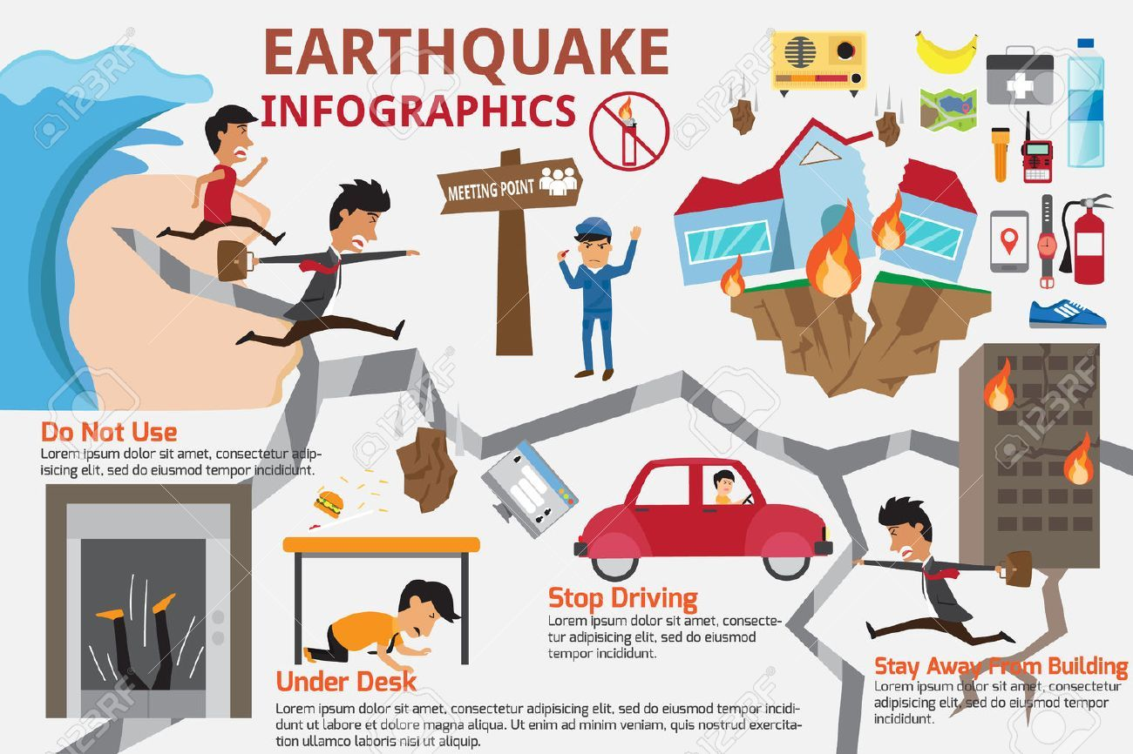
Preparedness and Mitigation
Preparedness involves taking proactive measures to minimize the impact of natural disasters.
This includes creating emergency plans, assembling disaster supply kits, and educating the public.
Mitigation focuses on reducing the vulnerability of communities through measures like building codes and land-use planning.
7

Slide 9
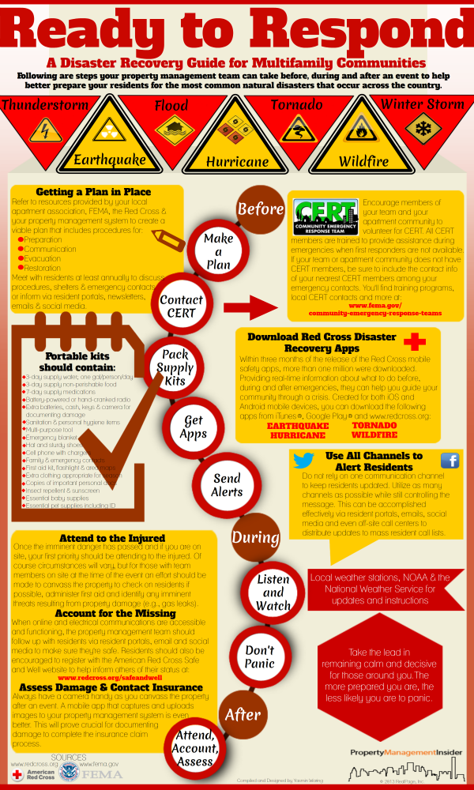
Response and Recovery
Response refers to the immediate actions taken to save lives and protect property during a natural disaster.
It involves emergency services, search and rescue operations, and providing essential supplies.
Recovery involves the long-term process of rebuilding and restoring affected areas after a disaster.
8

Slide 10
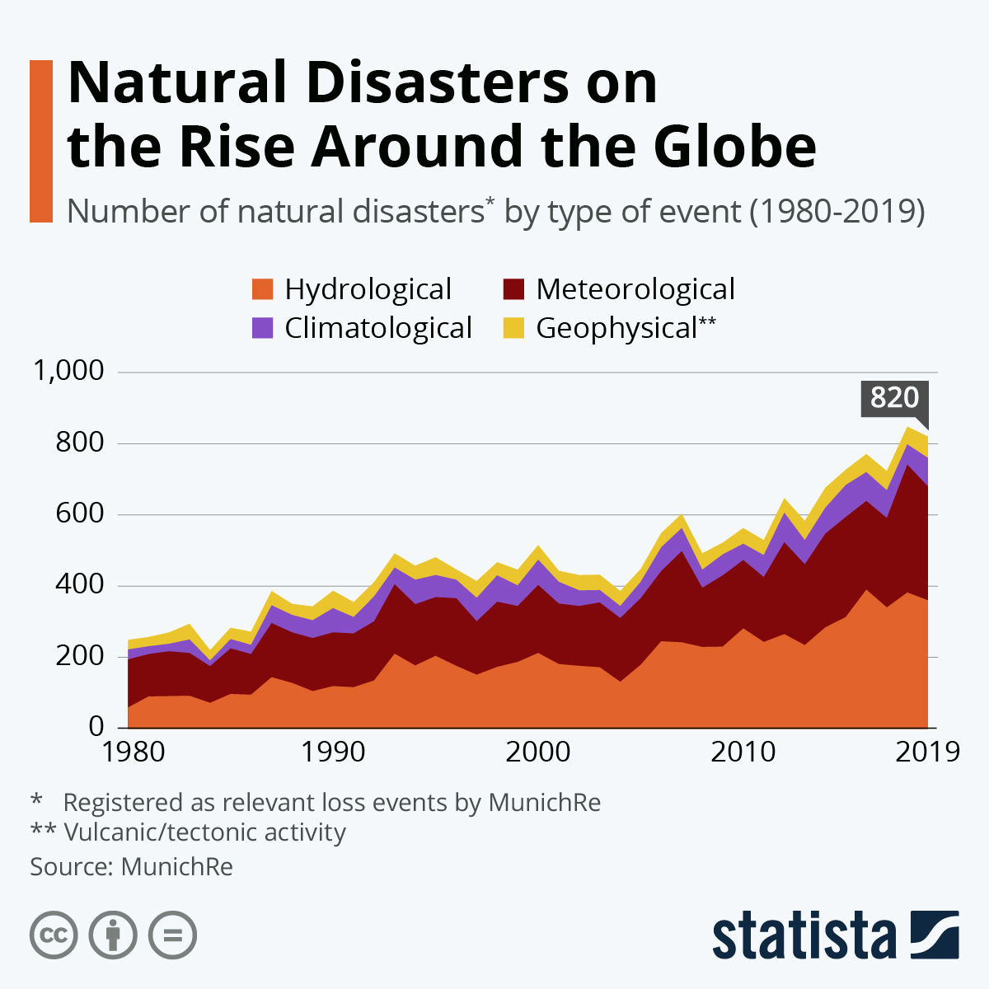
Climate Change and Natural Disasters
Climate change has the potential to increase the frequency and intensity of certain natural disasters.
Rising global temperatures can contribute to more severe storms, heatwaves, and sea-level rise.
Adapting to and mitigating the effects of climate change are crucial in reducing the risk of future disasters.
9

Slide 11
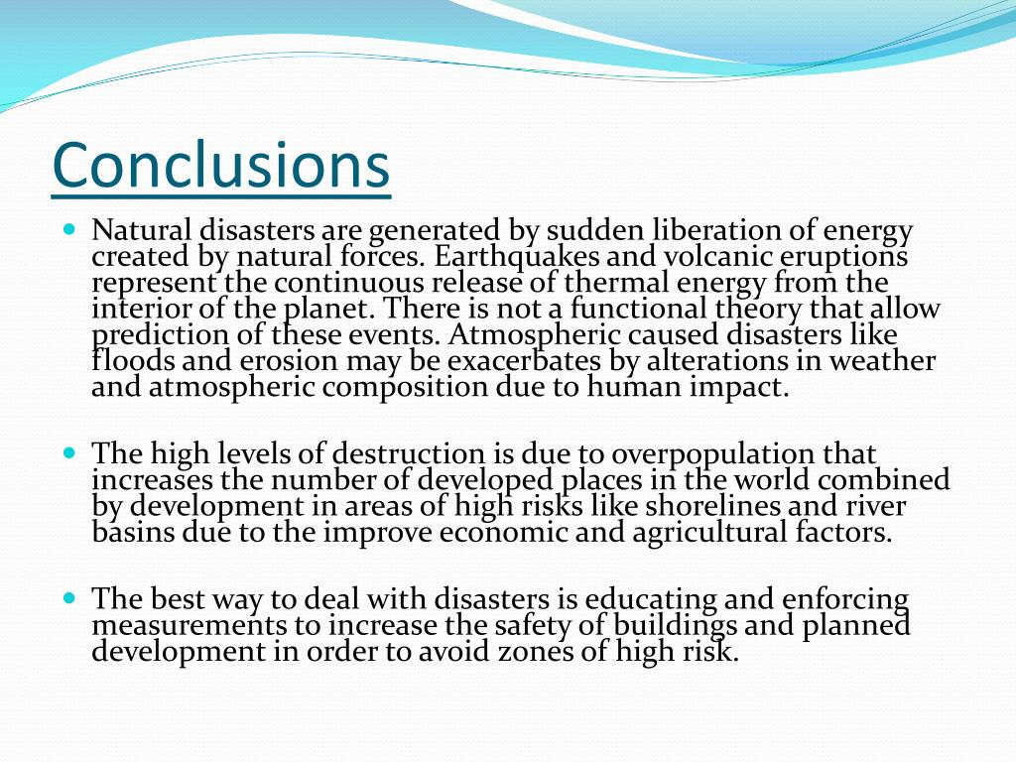
Conclusion
Natural disasters are unpredictable events that can have profound impacts on society and the environment.
By understanding the different types of natural disasters and implementing preparedness and mitigation measures, we can reduce their impact.
The importance of addressing climate change cannot be overstated in ensuring a safer and more resilient future.
10

